Slide 1
Finite time measurements
by Unruh-DeWitt detector
and Landauer’s principle
Vladimir Shevchenko
NRC «Kurchatov Institute»
Ginzburg Conference-2017
02 June 2017, Moscow, Russia

Slide 2
Based on:
V.Sh., Annals of Physics, 381 (2017) 17-40
V.Sh., arXiv:1607.07071
V.Sh., EPJ Web of Conferences, 95 (2015) 03034
2/30

Slide 3
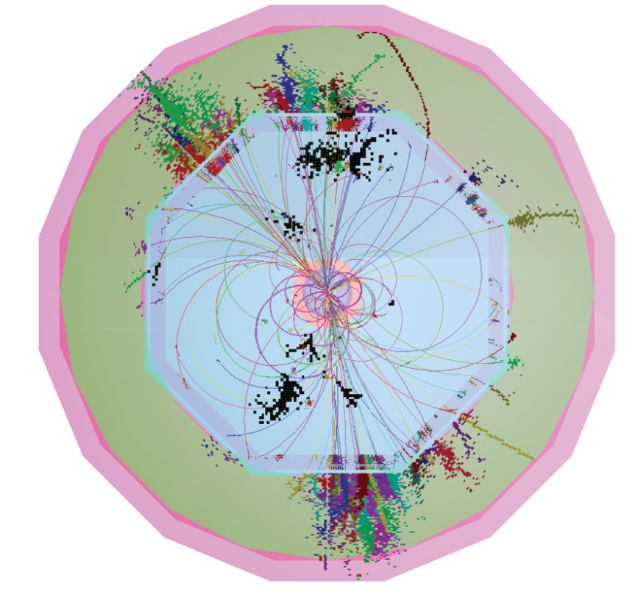
There is a fundamental problem in measurement theory:
how the dynamical scale comes out of artificial scales
UV scale
True physical scale
IR scale
In most cases in particle physics
we assume that physics here
is uncorrelated with physics here
All the standard QFT machinery
we use (asymptotic states, plane
waves basis for propagators etc)
is based on neglect of the physics
of detecting.
3/30

Slide 4
Seen from another prospective:
Defining quantum field theory means to define action and integration measure:
Measure encodes some a priopri known (or assumed) information about both IR- and UV-scales.
IR-example – ideal conductor
Casimir boundary conditions:
UV-example – regularization:
In renormalizable theories we need just a few numbers from the «outside» region to be able to work at low energy – coefficients of marginal operators, like 1/137.
We cannot compute them and get from experiment
4/30

Slide 5
There is a problem however – fine tuning
For quantum field theory defined on a lattice with
link a fields φ ~ a⁻¹ and a is natural scale for all dimensionful quantities.
We know from experiment in all these cases that 1/a terms are physically irrelevant.
However only in the last case
we have an idea how physical scale appears from a:
Ultimate reason behind all that is uncertainty relations
Heisenberg, Robertson–Schrödinger, Gabor, Bell,
Margolus-Levitin etc.
Not dynamical, hence very fundamental
5/30

Slide 6
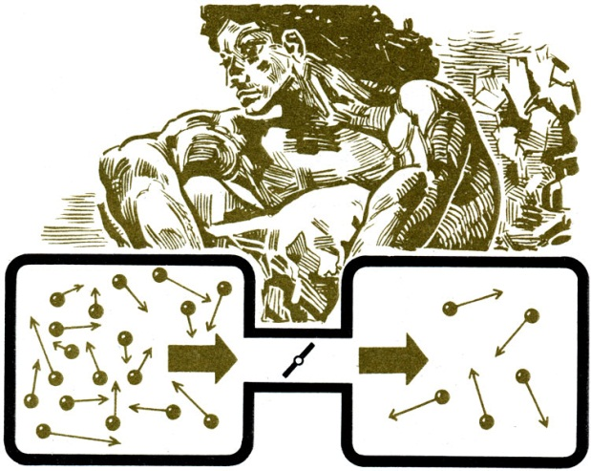
Another sort of constraints on measurements comes
from the fact that information is physical
R.J.E.Clausius, ‘1865
J.C.Maxwell, ‘1871 L.Boltzmann, ‘1886
J.von Neumann, ‘27
L.Szilard, ‘29
C.Shannon, ‘48
L.N.Brillouin, ‘53
E.T.Jaynes, ‘57
R.Landauer, ‘61
C.H.Bennett, ‘73
J.D.Bekenstein, ‘73
Information processing systems
(«hardware») are to obey the laws
of physics. It is less obvious, should
algorithms of computation («software»)
have intrinsic physics behind (and, in
particular, energy or entropy cost).
6/30

Slide 7
Landauer principle
R. Landauer, Irreversibility and Heat Generation in the
Computing Process, IBM Journal of Research and Development, 5 (1961) 83
Erasure of one bit of information at temperature T
must lead to dissipation of at least k_{B}T log 2
«Erasure» in this context means «reset». Generally, erasure is (almost) any operation that does not have single-valued inverse.
Forgetting is costly
For introduction to the subject see nice review
M.B.Plenio, V.Vitelli, The physics of forgetting: Landauer’s erasure principle and information theory, Contemporary Physics, 42 (2001) 25
7/30

Slide 8
«Even if you're not burning books, destroying information generates heat»
(picture from P.Ball, Nature News, Mar 7, 2012)
8/30

Slide 9
Experimental progress
S.Toyabe, T.Sagawa, M.Ueda, E.Muneyuki and M.Sano,
Experimental demonstration of information-to-energy conversion and validation of the generalized Jarzynski equality,
Nature Phys. 6 (2010) 988
A.Berut, A.Arakelyan, A.Petrosyan, S.Ciliberto, R.Dillenschneider, E.Lutz, Experimental verification of Landauer’s principle linking information and thermodynamics
Nature 483 (2012) 187
Interesting attempt to apply Landauer’s principle to
dynamics of self-replication of biological systems is
J.England, Statistical physics of self-replication,
Journal of Chemical Physics 139 (2013)121923 (2013);
«A New Physics Theory of Life»
– Quanta Magazine, ‘14
9/30

Slide 10
More refined formulation of Landauer’s principle
D.Reeb and M.M.Wolf, (Im-)Proving Landauer’s Principle
New J. Phys. 16 (2014) 103011
10/30

Slide 11
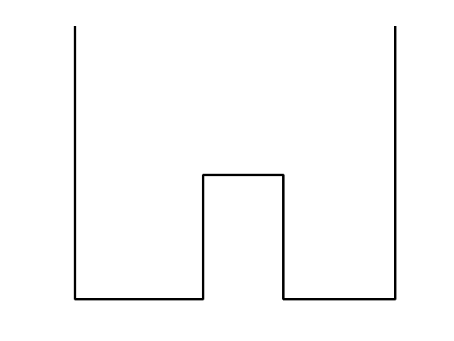
The simplest possible detector is two-state one:
Alternatively one can think about a pixel of macrodetector.
spatial separation
energy levels
Entropy:
Time evolution:
11/30

Slide 12
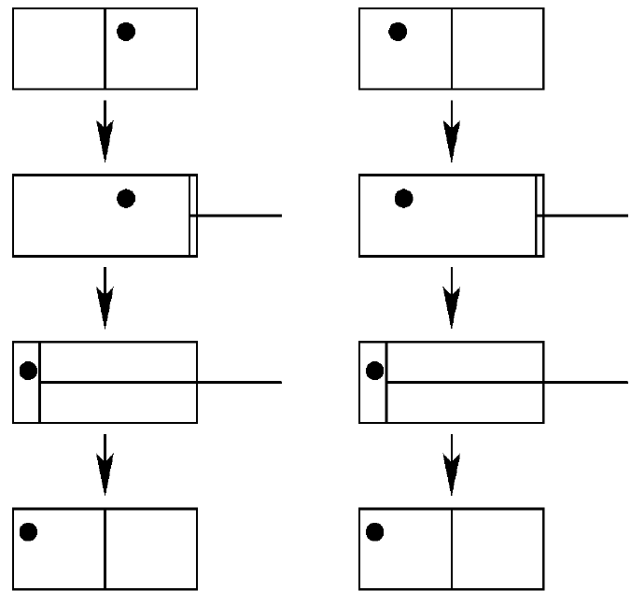
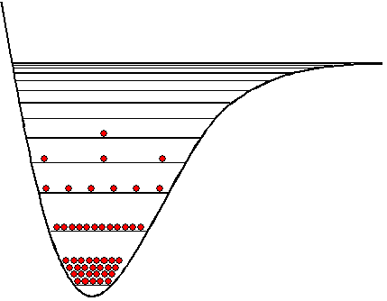
Erasure
«reset»
«soft»
erasure by
thermalization
…
E.Lubkin, ‘87
{0, 1}
↓
{(1-p) •0 + p•1}
{0, 1} → {0}
12/30

Slide 13
Evolution of Unruh-DeWitt point-like detector:
Measurement
window
Monopole operator
of the detector
Massless scalar
field on the detector’s worldline
Transition amplitude:
Probability:
We take this model for the memory unit
13/30

Slide 14
Usually this model is considered in perturbation theory for infinite time measurement:
Transition probability in unit time:
Unruh effect (W.G.Unruh, `76):
the detector moving
with constant acceleration
the detector at rest at temperature proportional to acceleration
14/30

Slide 15
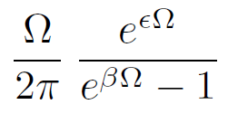
Dynamics enter via evolution law for transition probabilities.
In stationary limit the problem was analyzed in
Markovian approximation (A.Nitzan, R.J.Silbey, ’74):
For two-level detector
where coefficients are t-independent in this limit:
15/30

Slide 16
Thermalization in infinite time
Expected Boltzmann distribution.
No perturbation theory for infinite time.
Much less is known for finite time measurement
Problems:
Methods used to obtain evolution equation in stationary problem are not adequate in time-dependent case
Coefficients are divergent and need to be renormalized
L. Sriramkumar and T. Padmanabhan ‘94;
L.C.Barbado, M.Visser, ‘12; V.Sh., ’15, ‘16.
16/30

Slide 17
There are four different time scales when we speak about non-stationary measurements:
the detector energy levels difference
regularization parameter , related to the detector size
They can be considered as unrelated ones, even parametrically.
the typical thermal time
speed of the coupling change
internal
external
Formal expression for t-dependent coefficient function is:
It is divergent and vanishing of at zero temperature cannot be used as a renormalization condition anymore since switching process itself could excite the detector even in the vacuum.
17/30

Slide 18
Free scalar thermal field:
regularization by the size of the detector
Odd in Ω part takes care of the difference between excitation and decay.
18/30

Slide 19
Final result for the renormalized coefficients (V.Sh. ’15):
survives in stationary case
divergent
thermal
All terms but the second
one are finite
19/30

Slide 20
Renormalization:
Recovery time
Excitation probabilities
vanish for infinite energy
gap, as they should do
physically.
20/30

Slide 21
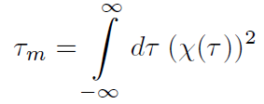
Forgetting the initial state is controlled by:
which can be rewritten in terms of the operator
where total measurement time is
21/30

Slide 22
Greisen-Zatsepin-Kuzmin bound
Proton moving along worldline
Excitation levels starts from some of the order of pion mass.
Excitation probability:
where
;
;
For probability of a click in unit time is small,
but for exponential suppression goes away
22/30

Slide 23
Perturbative switching off
scales as
Does not vanish in limit:
Thermal distribution of the detector’s levels
becomes non-thermal after switching off.
23/30

Slide 24
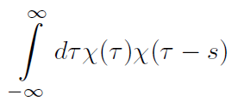
In finite time interaction case it is convenient to compute finite and well defined relative rates
for two-level detector
Notice that the perturbative probability does not depend on recovery time.
Formally it is because if convergent is even function of s.
for
It is worth noting that
where
Fields are quantum
24/30

Slide 25
The operator can be computed analytically for
various profiles, for example:
becoming sharp boundaries in limit
and simplifies considerably for
25/30

Slide 26
Quasi-stationary limit: leading finite time correction
where
All information about time profile of the measurement procedure is encoded in just one number in this limit
For example, for Gaussian shape
but
for two-parametric
tangential profile
(V.Sh. ’15; L.Garay et al, ‘16)
26/30

Slide 27
Application to the Landauer bound:
Constraint on the work of external force. Energy balance:
The physical meaning is clear – increase of the detector's free energy cannot exceed the work done by external force, otherwise one would be able to construct perpetuum mobile of the first kind.
It is also worth distinguishing «erasure» and «reset».
Final entropy is zero by definition in the latter case.
27/30
Notice that . Switching protocols leading to cannot be realized without external work.

Slide 28
This function has minimum at
Let the detector be initially in its ground state,
Naively one would say that final level distribution corresponding to full thermalization can be achieved with zero external work since the detector takes all required energy from the heat bath.
Instead bound starts to be nontrivial at the point where
The highest level of non-thermality allowed without thermodynamic penalty
28/30

Slide 29
Instead of conclusions
Any realistic measurement (or erasure) needs finite time. Finite time corrections can be important and can affect various bounds (like Landauer bound) in nontrivial ways.
29/30

Slide 30
Thank you for attention

